Slide 1
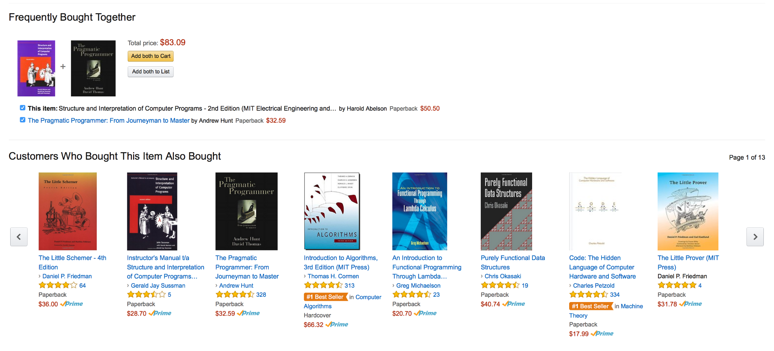
Examples OF Recommender SystemS
Amazon

Slide 2
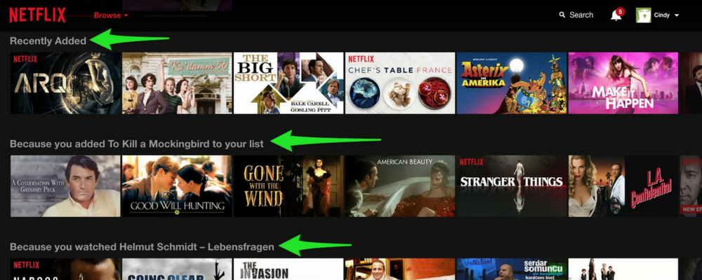
Examples OF Recommender SystemS
Netflix

Slide 3
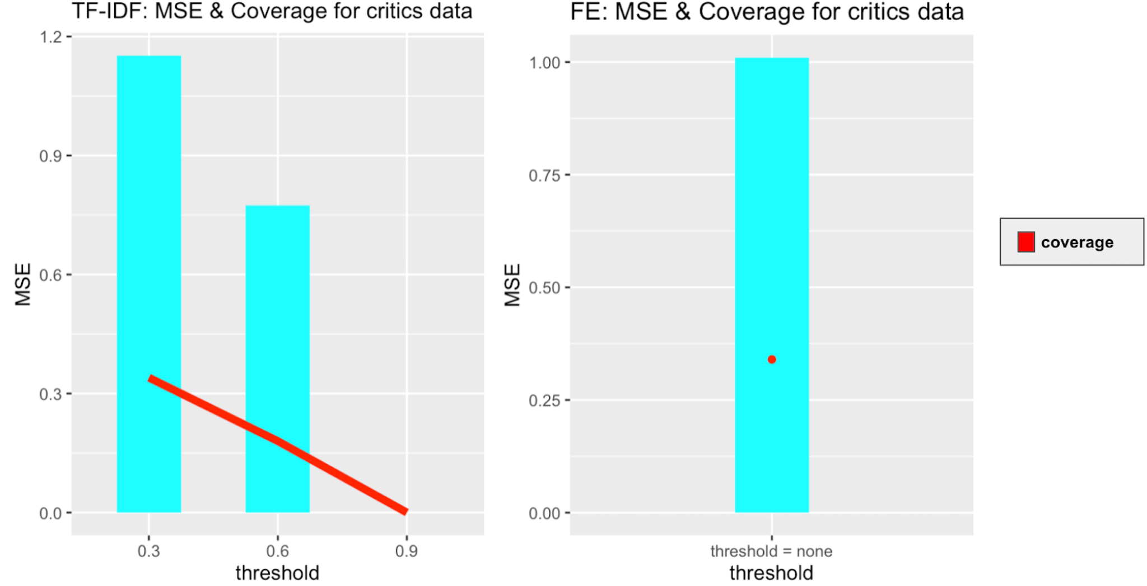
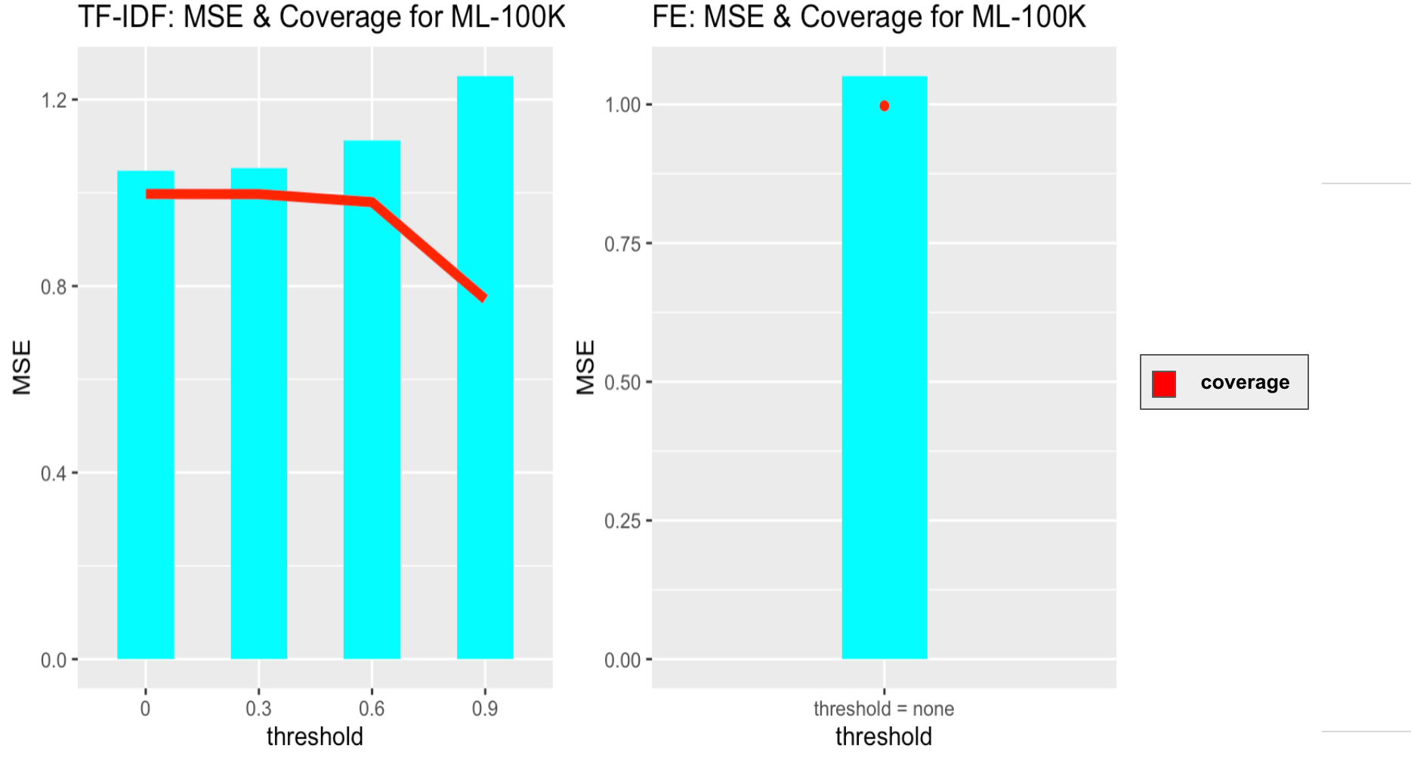
Experimental Design

Slide 4
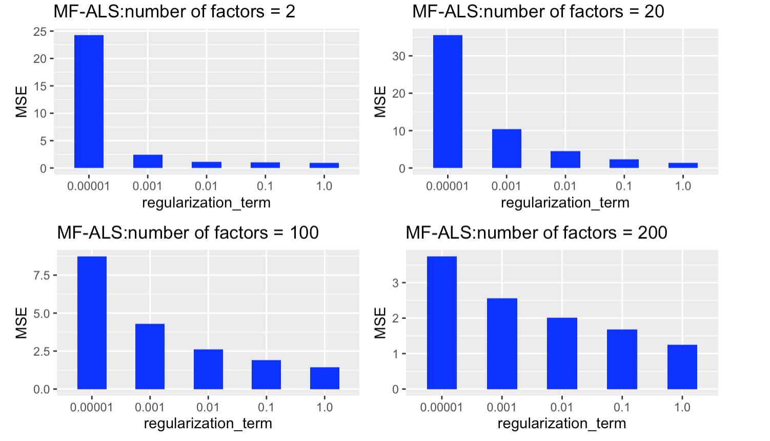
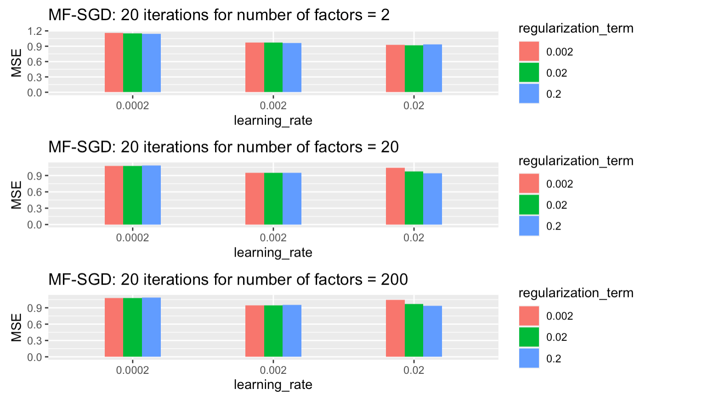

Slide 5
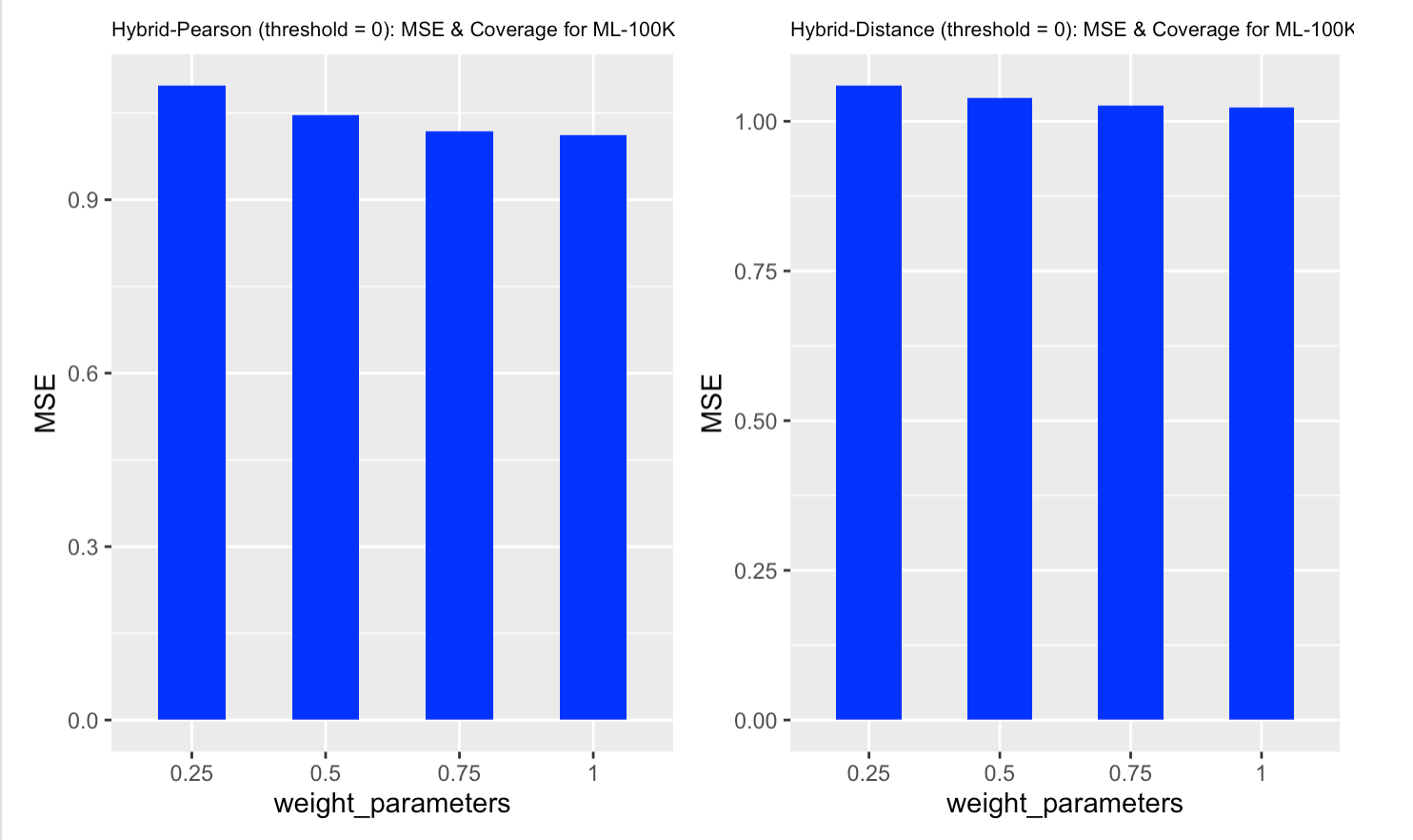

Slide 6
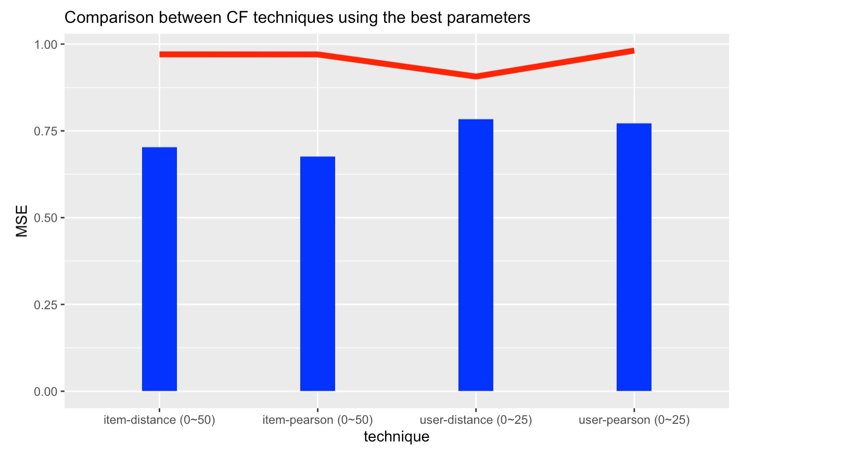
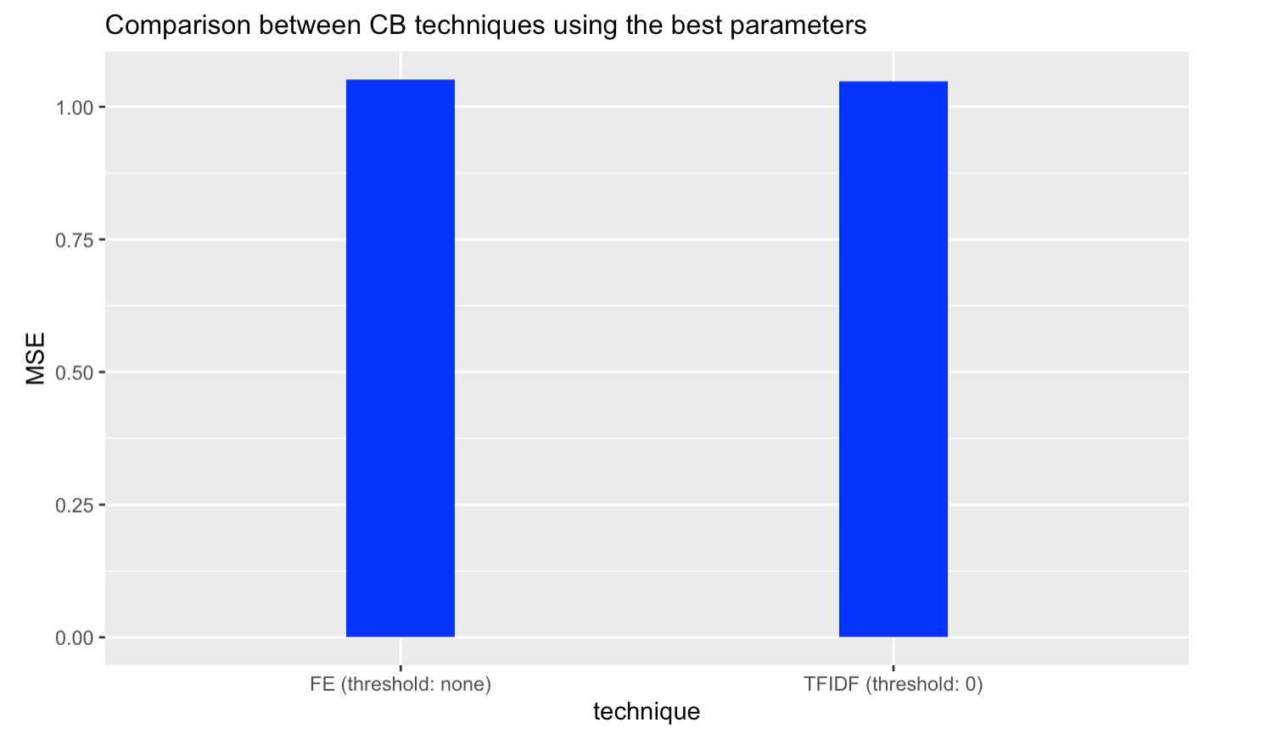
RESULTS AND DISCUSSION

Slide 7
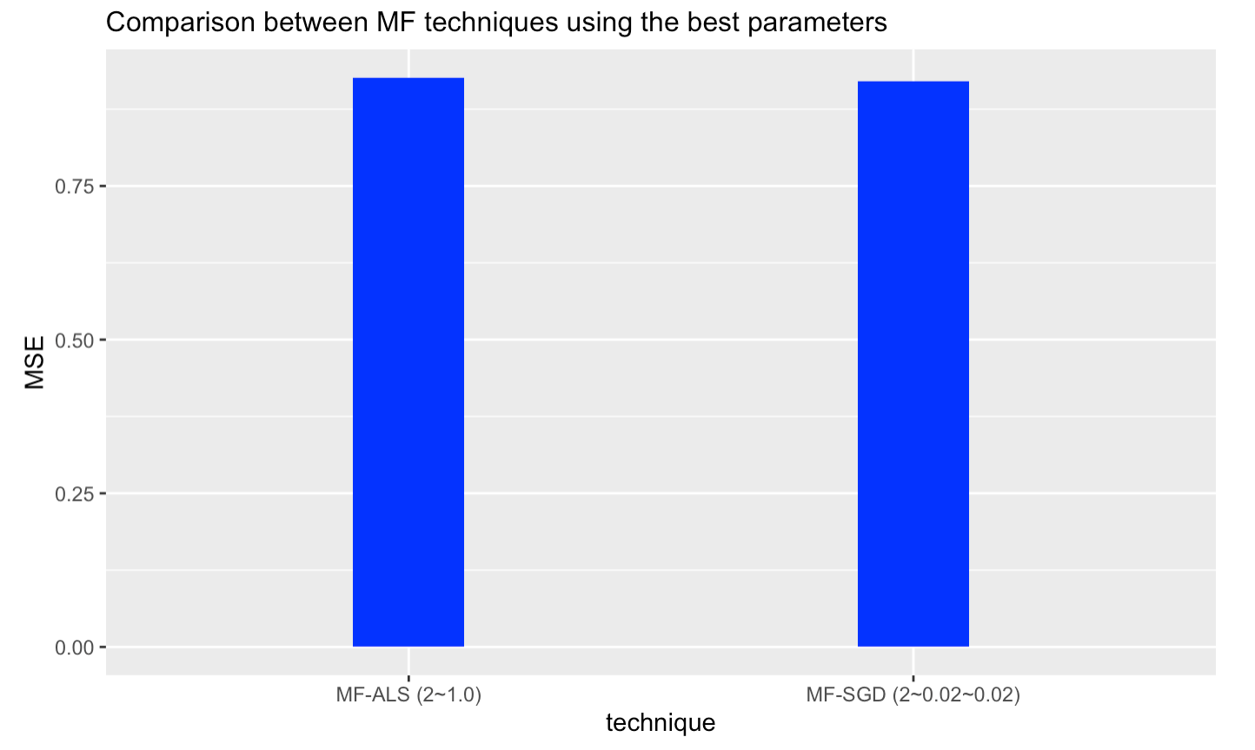
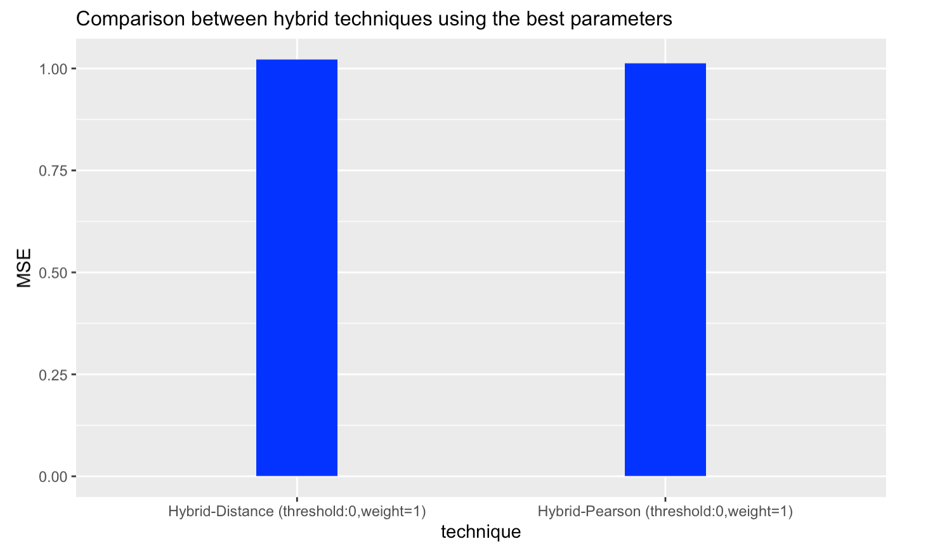

Slide 8
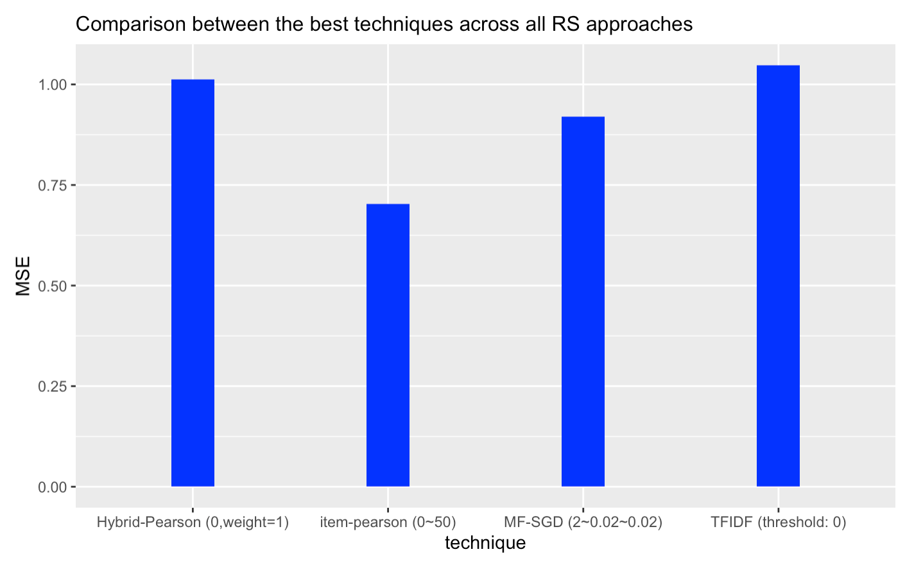

Slide 9
Critics | MSE | Coverage | P-Value
Item-based CF, distance sim Vs Hybrid-Pearson CF, pearson sim | 0.7033940428 , 1.0121751967 | 97029, 98124 | 0.001324
SGD, Vs FE | 0.9197552285,1.0517136 | 97504, 99743 | 1.80704e-108
Hybrid pearson CF, sim Vs SGD | 1.0121751967, 0.9197552285 | 98124 ,97504 | 5.53779e-57

Slide 10
CONCLUSION
Aligning with our original hypothesis, MF-SGD recommender system outputs the best accuracy and coverage.
Future work: implement lesser known methods, explore more hybrid approaches, test our algorithms on different types of dataset, such as books and foods data, having a dynamic dataset for our evaluation, and test our algorithms using runtime as a metric.

Slide 11
Thank You For LISteninG !

